Slide 1

CAR ACCIDENT SEVERITY
Shao Jiali
Aug 2020

Slide 2
Introduction
In this report, we want to study the factors that related to severity in collisions and predict the severity level based on the various factors. With this information, we hope to prevent or mitigate injuries resulting from car accidents in future.

Slide 3
Data
The data used in this study is accidents data for Seattle City. It includes all collisions data provided by SPD and recorded by Traffic Records from 2004 to present, in weekly frequency.
Data is in structural format. Target variable is SEVERITYCODE, where a numeric code is used to indicate whether it is fatality, serious injury, injury, prop damage, or unknown. The data is further processed to be a binary problem, so that 1 indicates injury in the accident and 0 indicates no injury in the accident.

Slide 4
Data
Feature used in this study include:
ADDRTYPE: collision address type, whether it is Alley, Block, or Intersection
UNDERINFL: whether or not a driver involved was under the influence of drugs or alcohol
WEATHER: a description of the weather conditions during the time of the collision
ROADCOND: the condition of the road during the collision
LIGHTCOND: the light conditions during the collision
SPEEDING: whether or not speeding was a factor in the collision the collision

Slide 5
Methodology
Decision Tree model is used for this classification problem
Decision Tree’s output of feature importance will help us identify the relative important features that will resulting in injuries in car accidents, and this will further help us to identify ways to prevent or reduce future injuries.

Slide 6
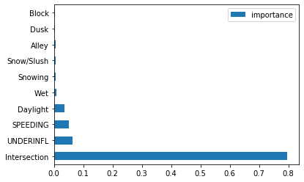
Results
Address type is the most import feature when it comes to the likelihood of injury occurred during accidents.
When a collision is at an intersection, such collisions are more likely to result in injuries.
When a driver is under influence of drug or alchohol, or when a driver is speeding, a collision is also more likely to result in injuries.

Slide 7
Conclusion
With the result of this study, we can help reduce the likelihood of injuries in accidents by placing more safety measures at intersections, or introducing more measures to identify drunk or speeding drivers.
For future studies, we can also include a more detailed analysis of other factors, by collecting more comprehensive data, for example, if safety belt is used, or by recording the time of the accident more accurately.

